Slide 1
Air Combat Simulator
Yanzhi Wang

Slide 2
Introduction
Project imitates Ace Combat.
Mouse controls flight direction.
W/S control throttle.
A/D control yaw.
C switches camera.
Press Space to launch tracking missiles after locking the target.
Game ends after shooting down all enemy planes or being shot down.
You can choose the number of enemies, reverse mouse and vector input.

Slide 3
Game Structure design
Input Module: Encapsulates input as functions for flight and weapons systems to call, allowing for multi-key expansion.
Flight System: Uses rigid body to simulate basic aerodynamics.
Weapon System: Can automatically switch targets in front of the aircraft and lock on. Once locked on, missiles can track the target.
HUD System: Provides real-time feedback on the aircraft's posture, which is similar to a real HUD in effect. The HUD can also guide tracking of enemies and provide lock-on information.

Slide 4
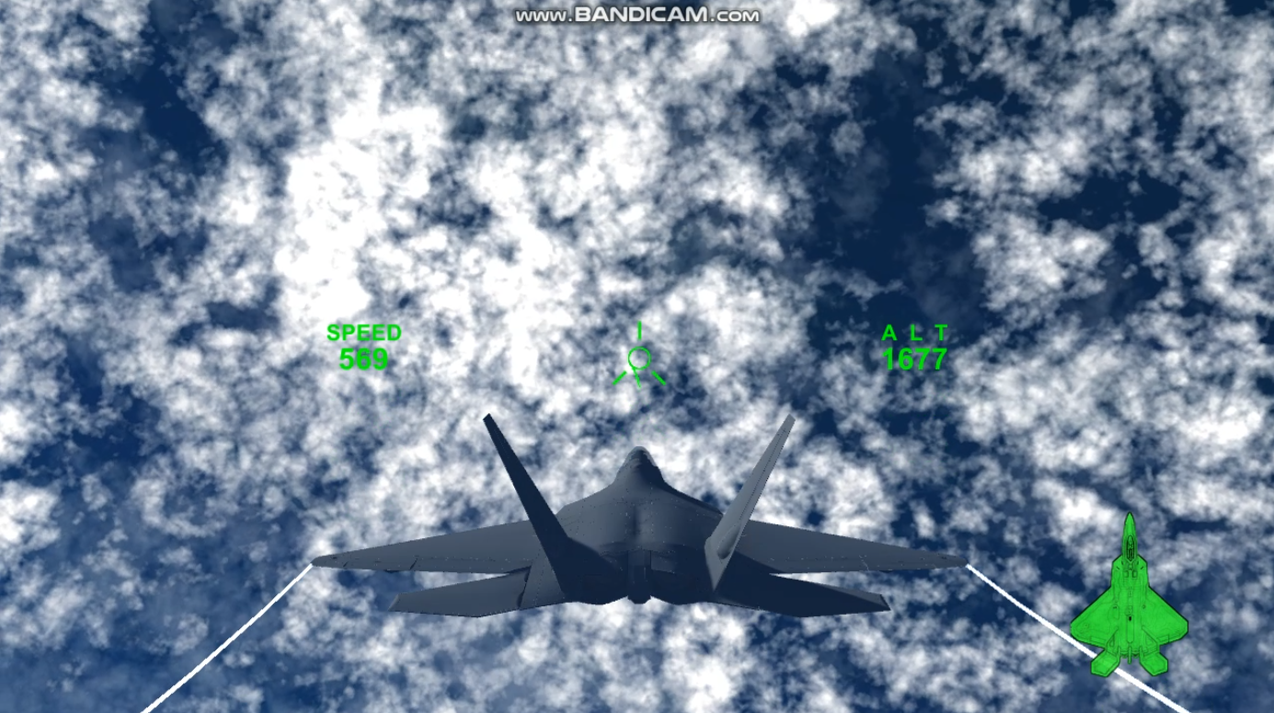
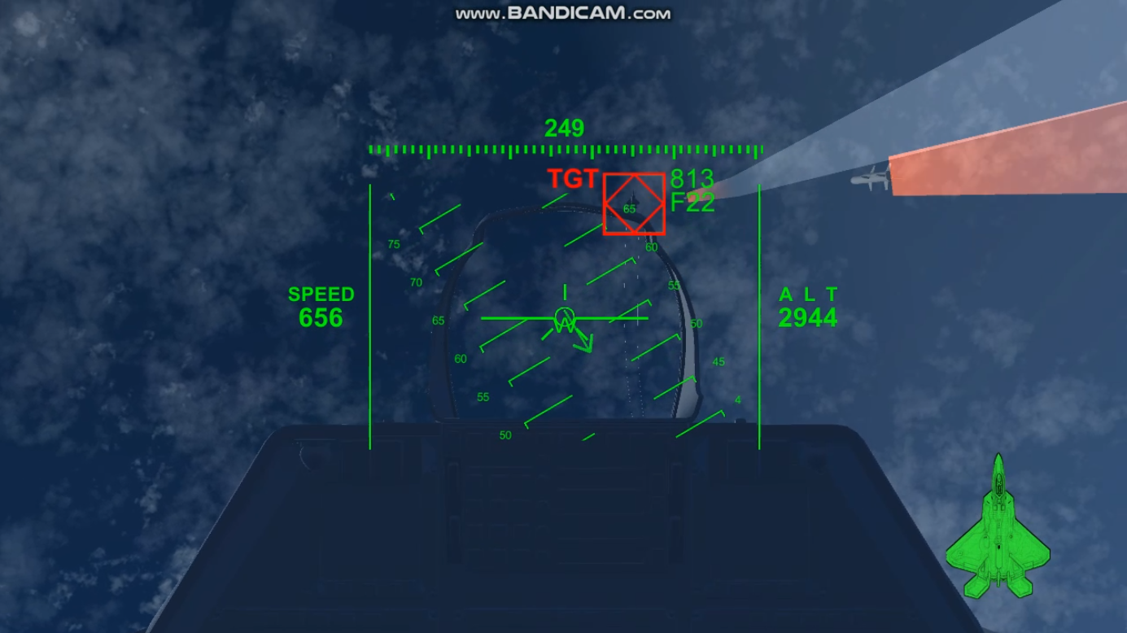
Gameplay

Slide 5
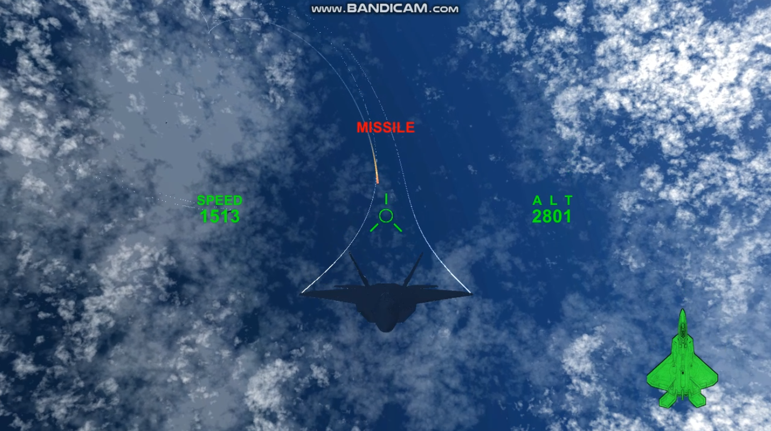
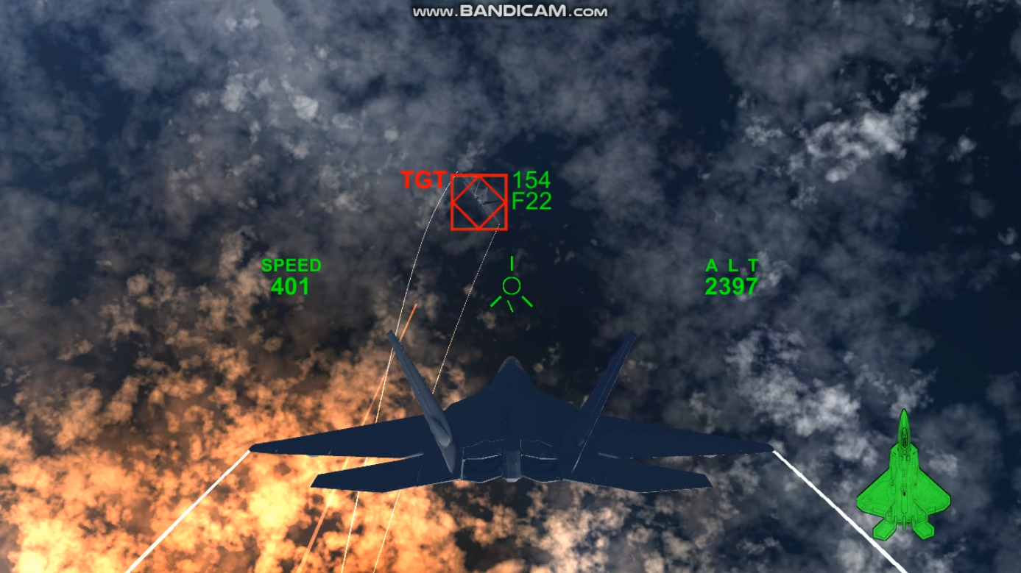
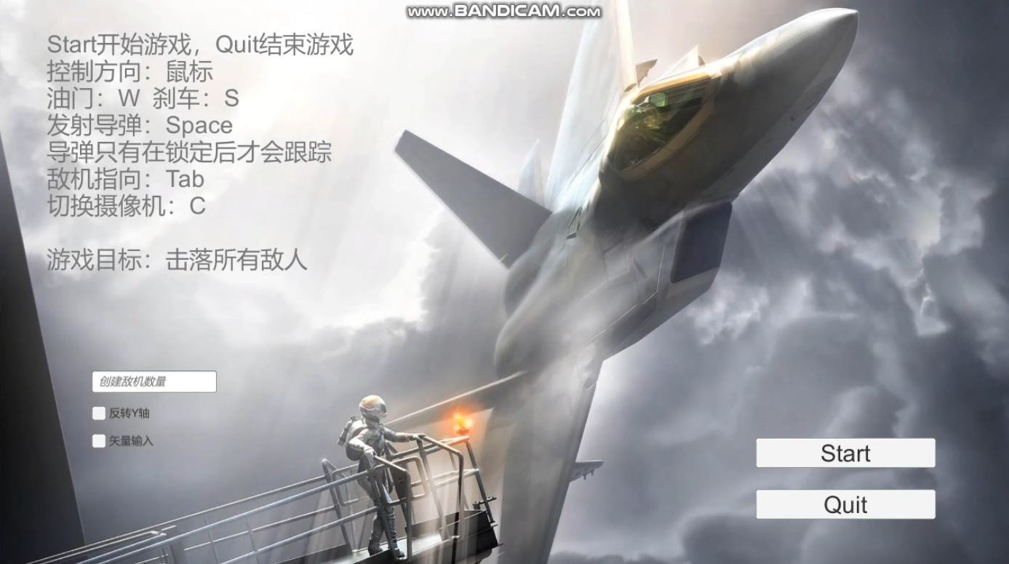
Gameplay

Slide 6
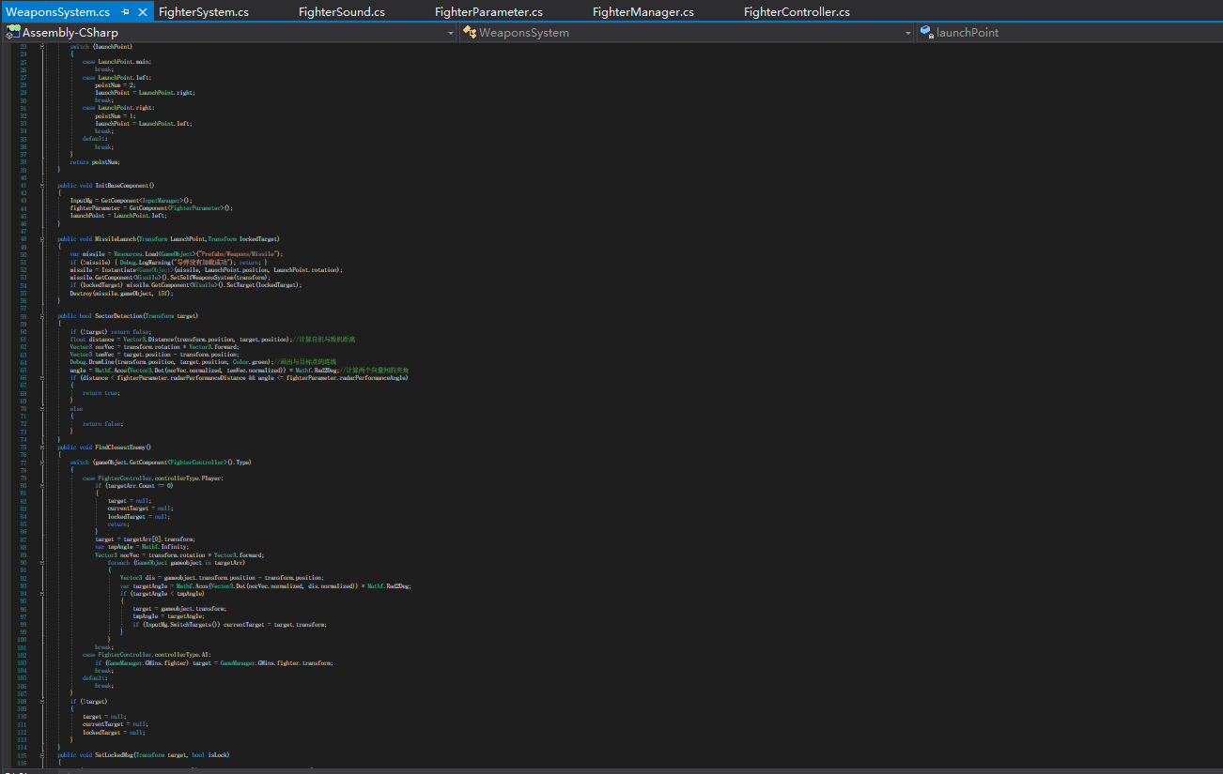
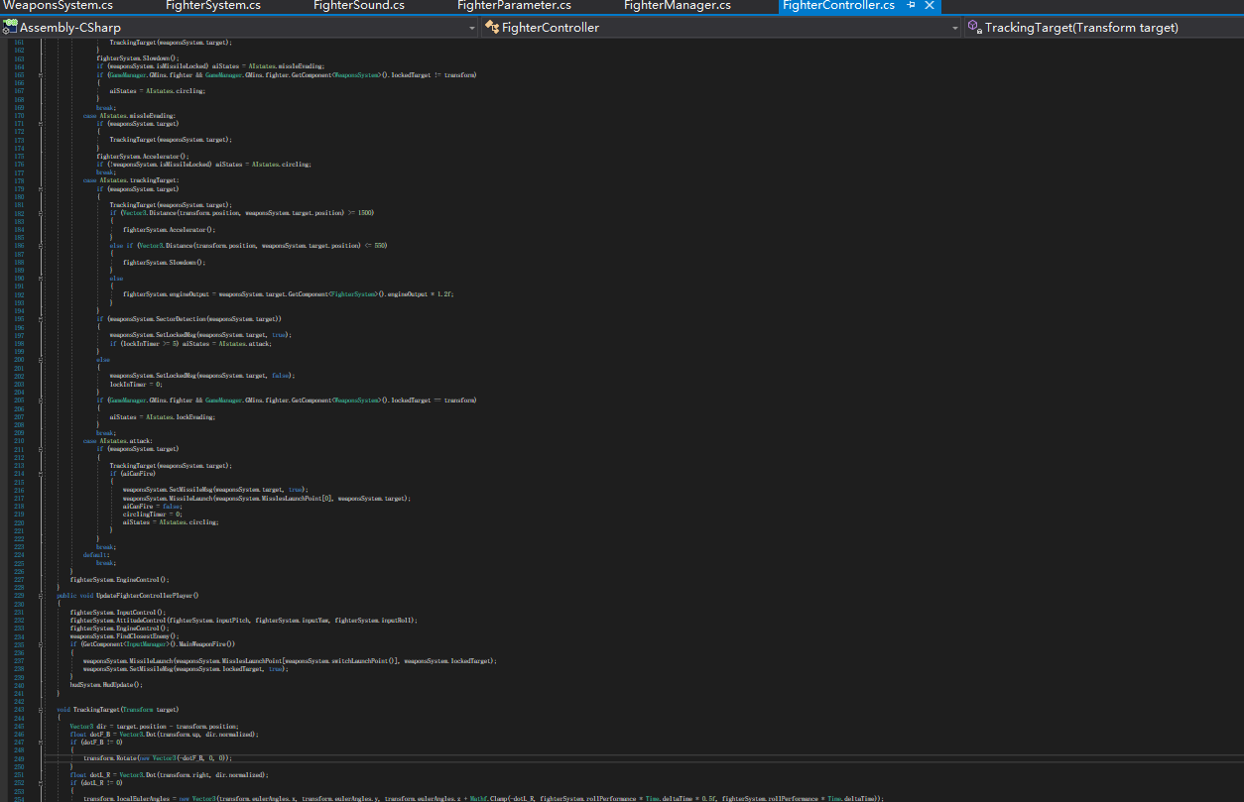
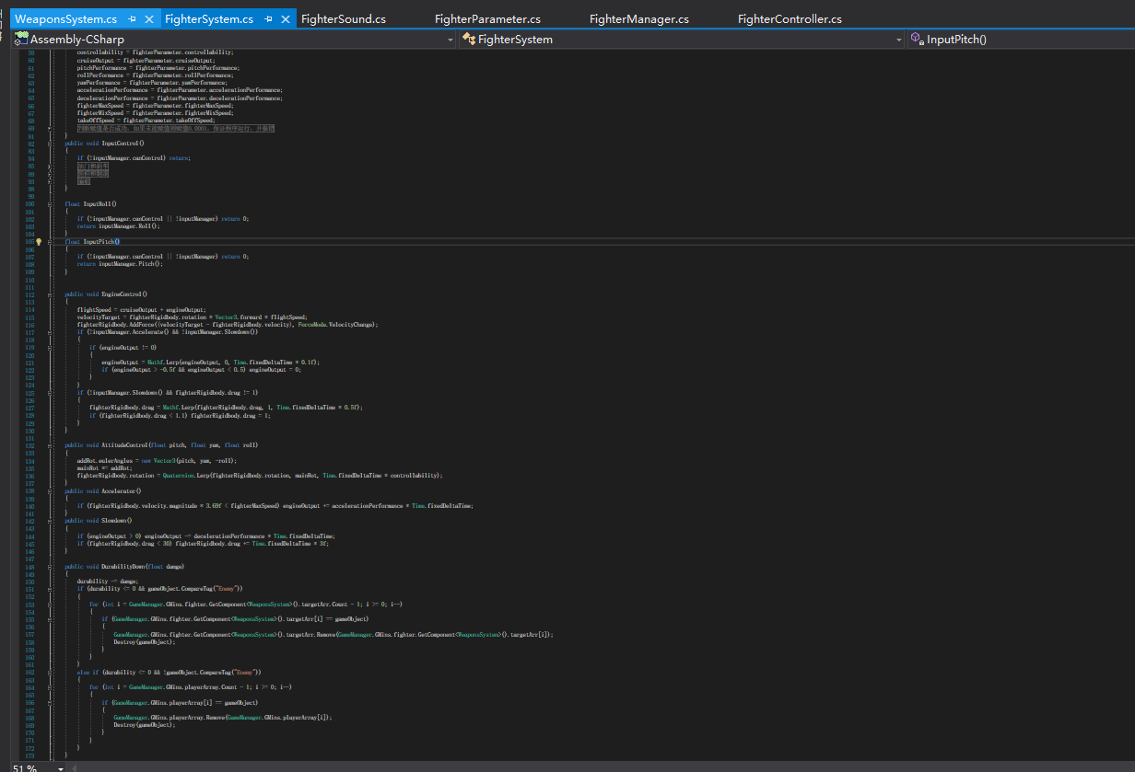
Editor and code

Slide 7
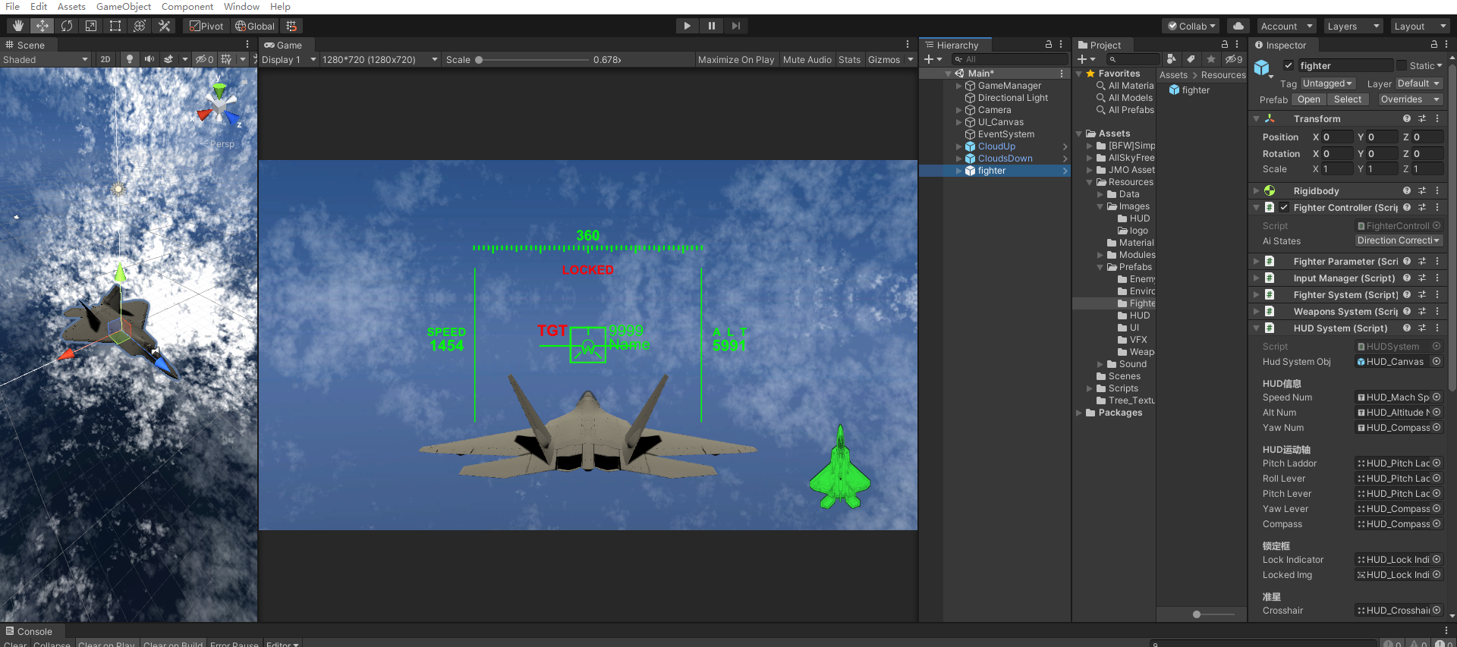
Editor and code

Slide 8
Project reflection
The design is not well thought out, which leads to some functions being unreasonable, such as the enemy lock-on box should be displayed based on the camera's position, but in the project, it is displayed based on the position of the aircraft, which causes the enemy's position to not be displayed when switching to a different camera view.

